Slide 1

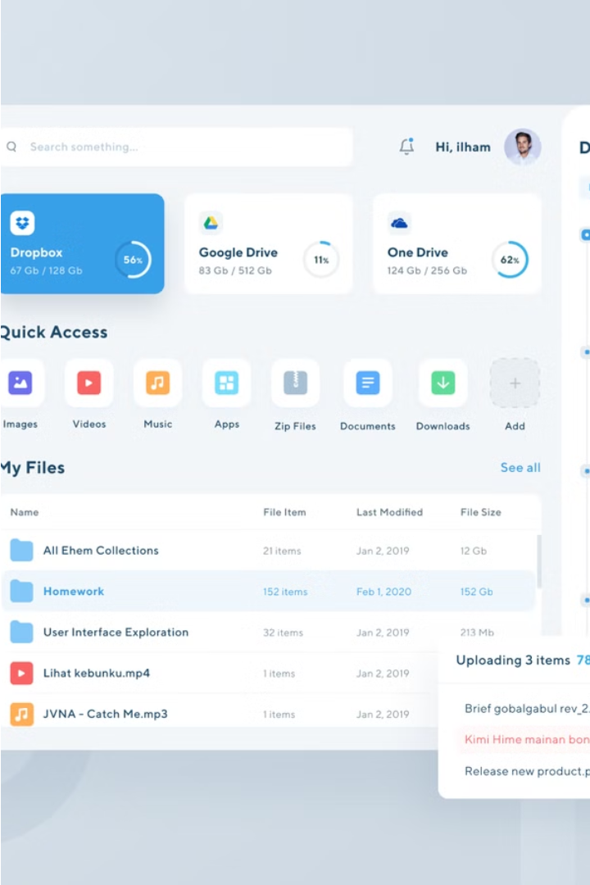


File Manager Application
Streamline your digital file organization with a powerful file management tool. Easily navigate, backup, and sort files with a user-friendly interface.
by Yash Kumar Singh

Slide 2
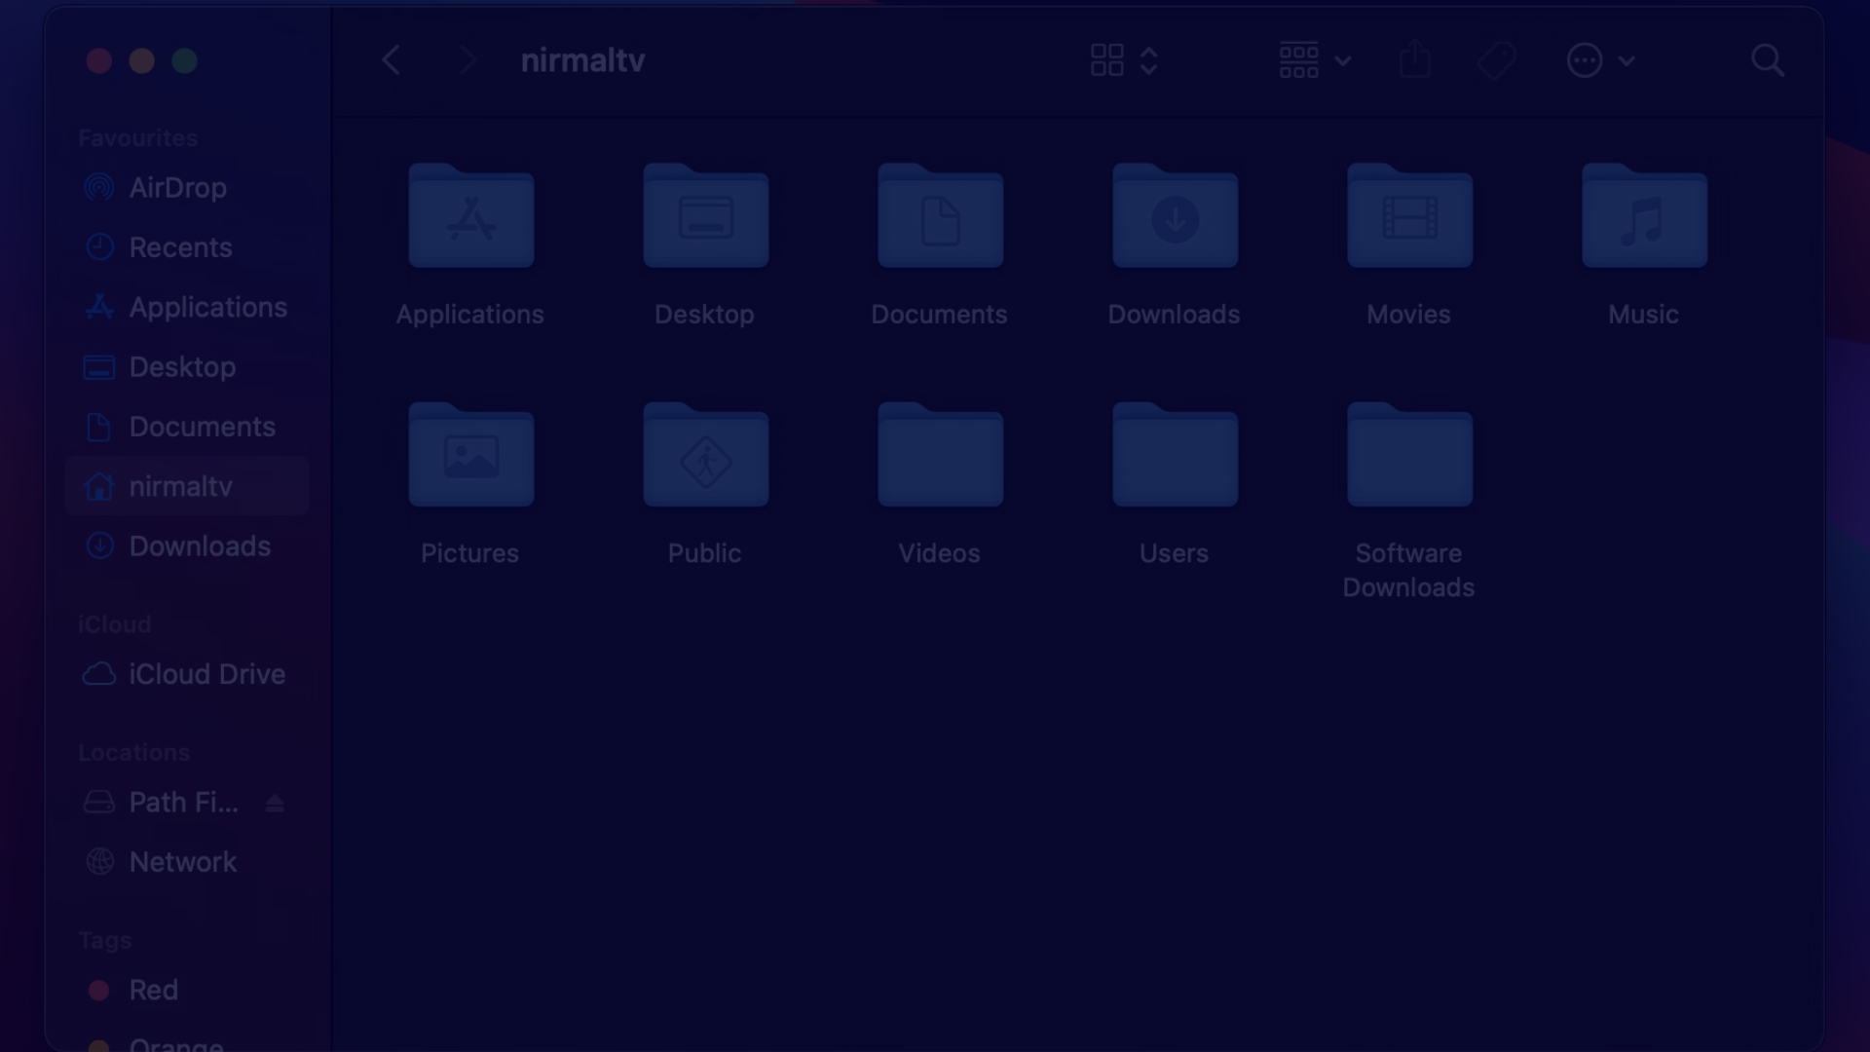
Introduction
1
Comprehensive File Control
2
Automated Workflows
3
Visual Analytics
Gain insights into your file usage and storage with detailed summaries and visualizations.
Manage your files and folders with advanced features for organizing, securing, and accessing your digital content.
Save time with customizable actions to sort, backup, and optimize your file system.

Slide 3
Source Directory Selection
Browse Directories
Recent Locations
Custom Paths
Easily navigate your file system to choose the desired source directory for organization.
Quick access to previously used source directories for efficient repeat tasks.
Ability to enter specific file paths or URLs to manage remote or cloud-based content.

Slide 4
Folder Options
Predefined Folders
Custom Folders
Choose from a set of common organizational folders like "Documents", "Photos", "Music", and more.
Create your own specialized folders to match your unique file organization needs.
Naming Conventions
Folder Hierarchy
Apply intelligent naming patterns to new folders for consistent and clear file storage.
Organize files into a nested folder structure for advanced organization and searchability.

Slide 5

Backup Functionality
Backup Source
Backup Schedule
Select the files and folders to be backed up before organizing.
Set automatic backup intervals to ensure your data is regularly protected.
1
2
3
Backup Destination
Choose a secure location to store the backup, such as a local drive or cloud storage.

Slide 6
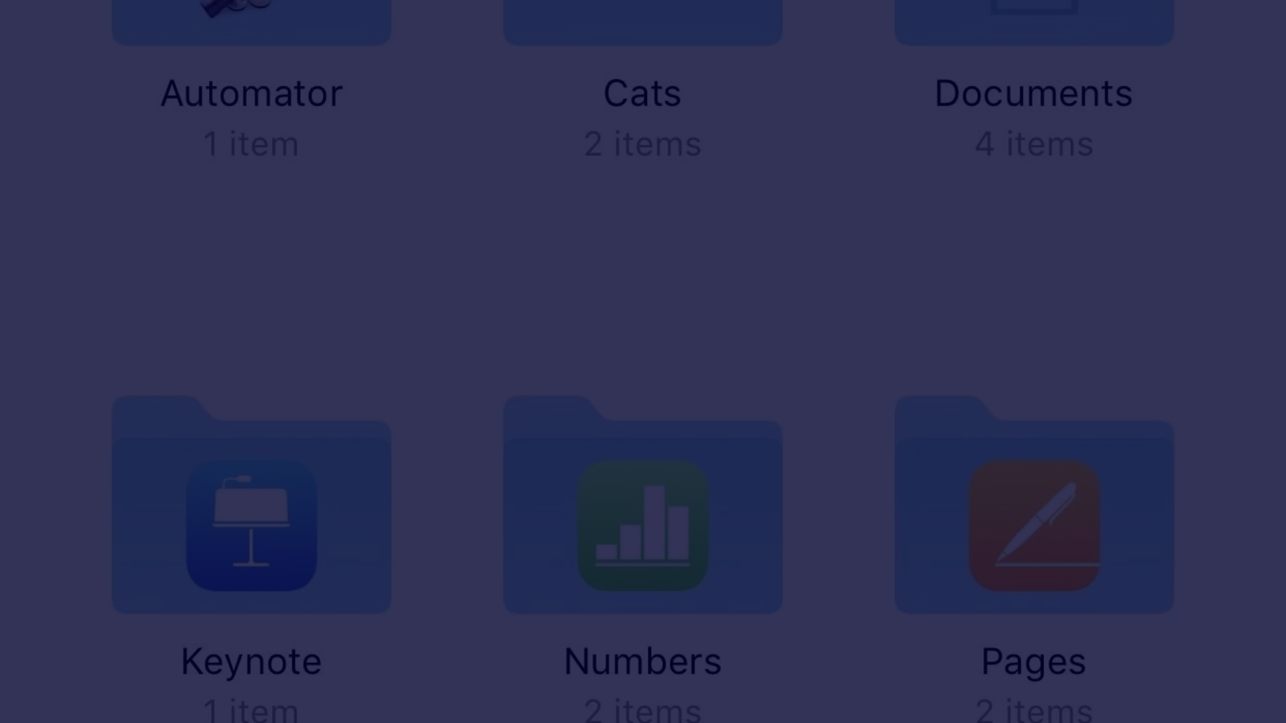



File Organization by Extension
Detect Extensions
Create Folders
Move Files
Identify the file types present in the source directory.
Automatically generate folders based on the detected file extensions.
Relocate files to their respective folders for clean organization.

Slide 7
Summary Report
File Type
Count
Total Size
Documents
142
256 MB
Images
789
1.2 GB
Videos
45
512 MB
Audio
67
128 MB
Others
23
64 MB

Slide 8

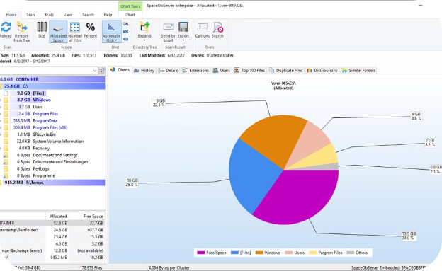
Visualization of Summary
File Type Distribution
Storage Usage
A clear visual breakdown of the file types and their relative sizes within the source directory.
A concise pie chart illustrating the overall storage consumption and allocation across different file categories.

Slide 9




Intuitive User Interface
Simple Navigation
Customizable Options
Informative Dashboard
Automated Workflows
Easily browse and manage files and folders with a clean, intuitive directory tree.
Tailor the application's behavior and appearance to suit your personal preferences.
Gain at-a-glance insights into your file storage with real-time data and visualizations.
Streamline repetitive tasks with powerful automation tools to save time and effort.

